Slide 1

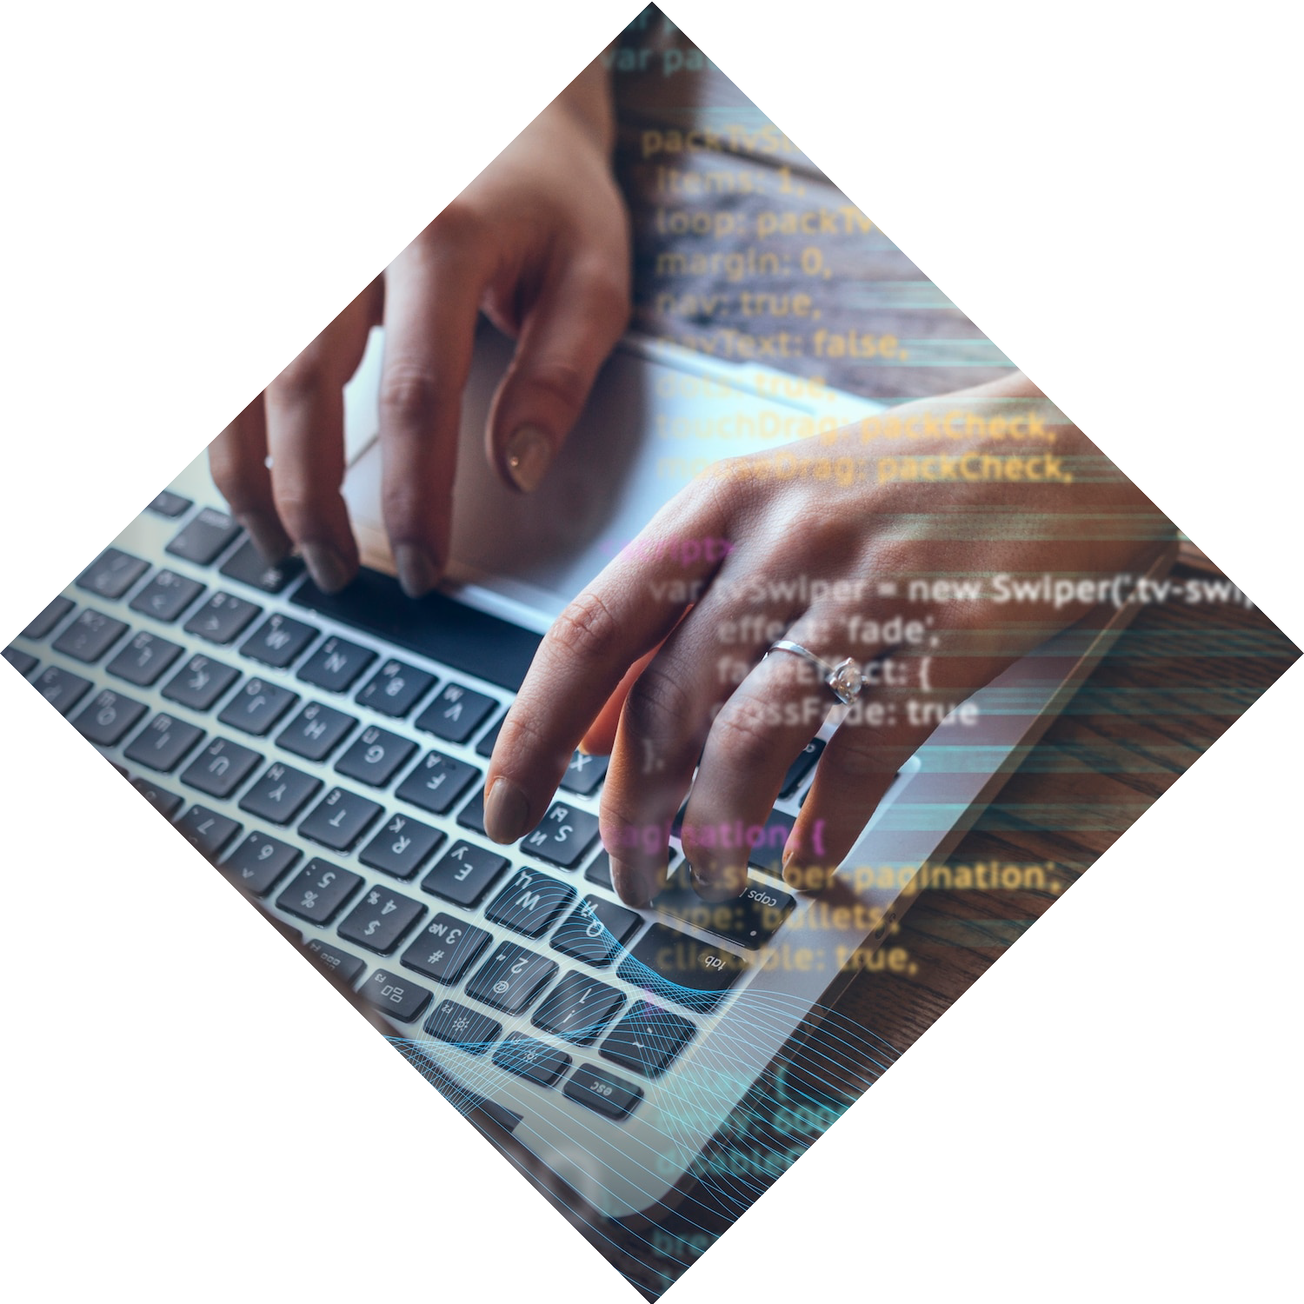
Mastering the Python Dictionary: Advanced Techniques and Applications

Slide 2


Introduction
In this presentation, we will explore techniques for mastering the
Python . We will cover various and best practices for eﬃcient
of dictionary data structures.

Slide 3

Understanding Dictionaries
A in Python is a powerful data structure that stores key-value pairs. It allows for access and manipulation of data. Understanding the of dictionaries is crucial for eﬃcient programming.

Slide 4

Advanced Dictionary
Methods
Python provides a variety of for advanced dictionary manipulation, including update(), pop(), and setdefault().
Understanding these methods is
essential for
use of dictionaries.

Slide 5
Dictionary Comprehensions
Dictionary are a concise way to create dictionaries in Python. They provide a mechanism for transforming one dictionary into another based on certain criteria.

Slide 6

Nested Dictionaries
Nested dictionaries allow for data structures by nesting dictionaries within other dictionaries. This technique is
for representing hierarchical data.

Slide 7


Dictionary Applications
Dictionaries have
applications, including data
,
conﬁguration settings, and representing entities. Understanding these applications is essential for programming.

Slide 8
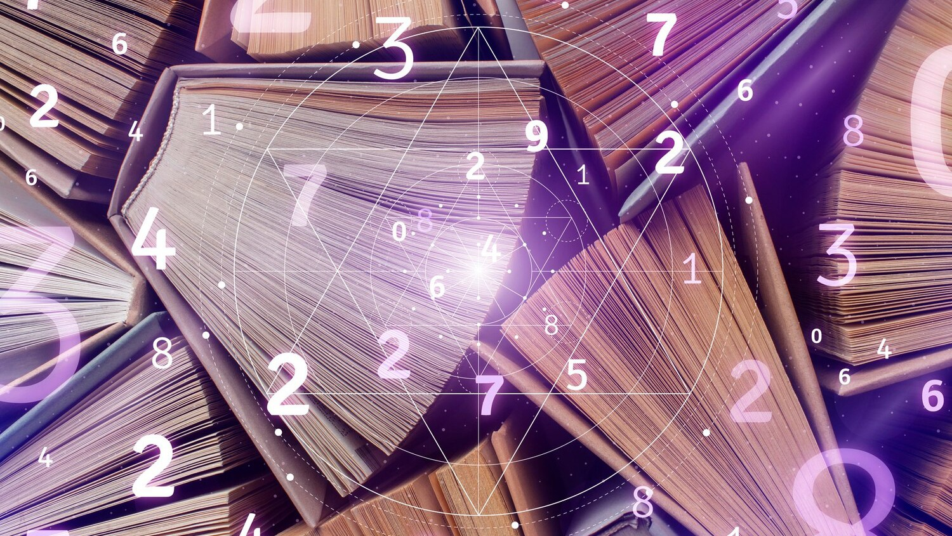
Efficient Data Retrieval
Using dictionaries for data retrieval is a common practice in
Python. Techniques such as
and indexing can optimize data
access and improve
.

Slide 9



Dictionary Best Practices
Implementing practices when working with dictionaries is crucial for
code readability and performance. This
includes proper eﬃcient data
conventions and
.

Slide 10

Handling Dictionary
Errors
Understanding how to handle
and exceptions related to dictionaries is important for programming.
Techniques such as using try- except blocks can ensure
error handling.

Slide 11
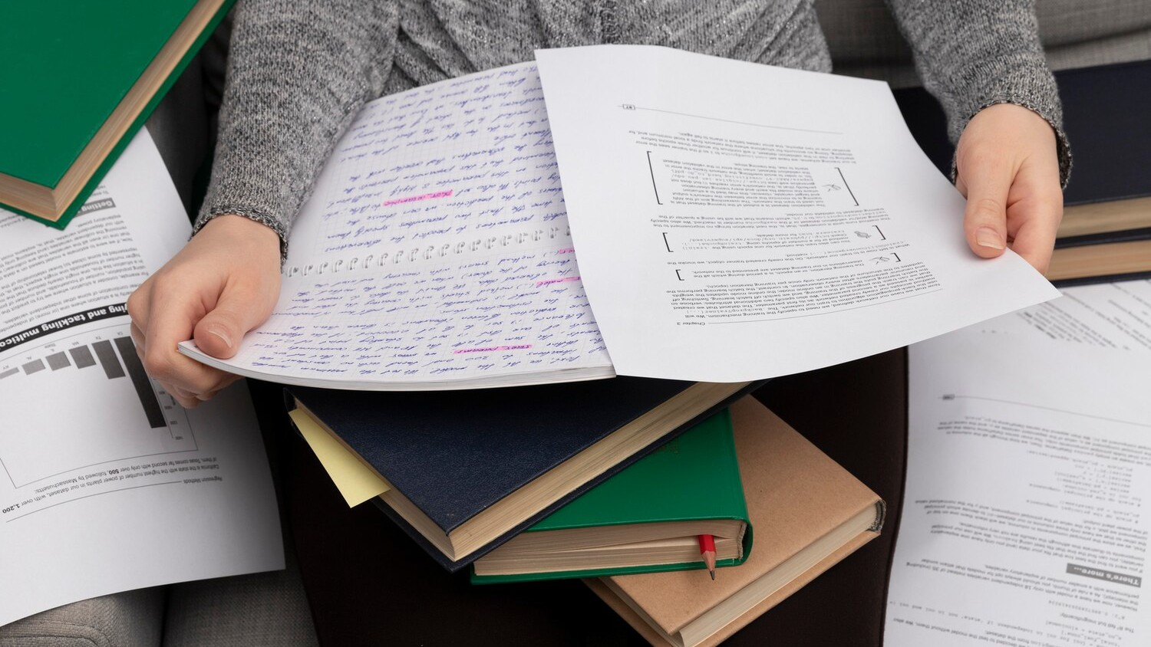

Dictionary Serialization
Serialization of dictionaries is crucial
for
and
. Techniques such as
and serialization enable dictionaries to be stored and exchanged eﬃciently.

Slide 12
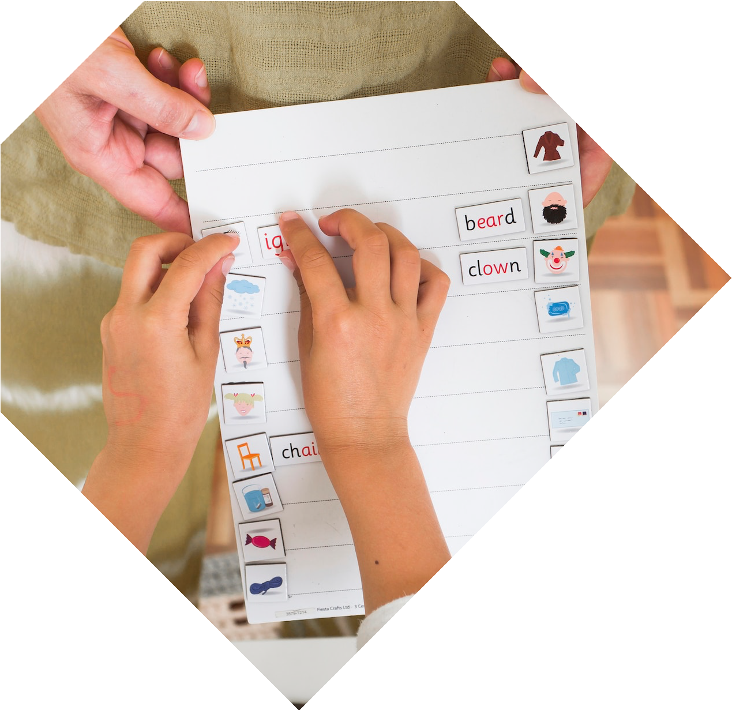

Dictionary Performance Optimization
Optimizing dictionary
involves techniques such as minimizing
usage and reducing Understanding these optimization strategies is essential for applications.
times.

Slide 13


Real-world Applications
Dictionaries are widely used in real-world applications such as systems,
development, and
computing. Understanding these applications is essential for Python programming.

Slide 14


Case Studies
Exploring
studies of using
dictionaries in scenarios can provide valuable insights into their applications. We will analyze case studies from various
.

Slide 15



Best Practices Recap
Recapping the practices and techniques for mastering dictionaries will
reinforce ensure applications.
programming habits and
performance in Python

Slide 16


Future Trends
Exploring the dictionary usage, such as
trends in
dictionaries and serialization techniques, can provide insights into the evolving landscape
of Python programming.

Slide 17


Challenges and Opportunities
Identifying and
in
mastering dictionaries will help in preparing for programming scenarios and leveraging dictionaries for
solutions.

Slide 18


Conclusion
Mastering the Python
empowers
developers to build , , and applications. Understanding advanced
techniques and applications is essential for
Python programming.

Slide 19



Thanks!
Do you have any questions?
youremail@email.com
+91 620 421 838
www.yourwebsite.com @yourusername

